Slide 1

APPLICATION OF GRAPH THEORY TERM PROJECT PRESENTATION PROJECT TITLE : NIU PATHFINDER ( Shortest Distance between NIU Computer Science building and famous eateries and recreational spots in Dekalb )
Omer Bin Ali Bajubair (Z1905006) Shalini Reddy Challa (Z1931066) Abrar Athar Hashmi (Z1933888)

Slide 2
Overview
Executive Summary
Output Graphical User Interface
Data Preparation
Algorithm for Graph Model
Results
Programming language & system
Future Enhancement

Slide 3
Executive Summary
NIU PATHFINDER
Help students studying in NIU Computer Science building to find the fastest and shortest path between the source ( Computer Science Building) to famous eateries and recreational spots in Dekalb which is the destination target.

Slide 4

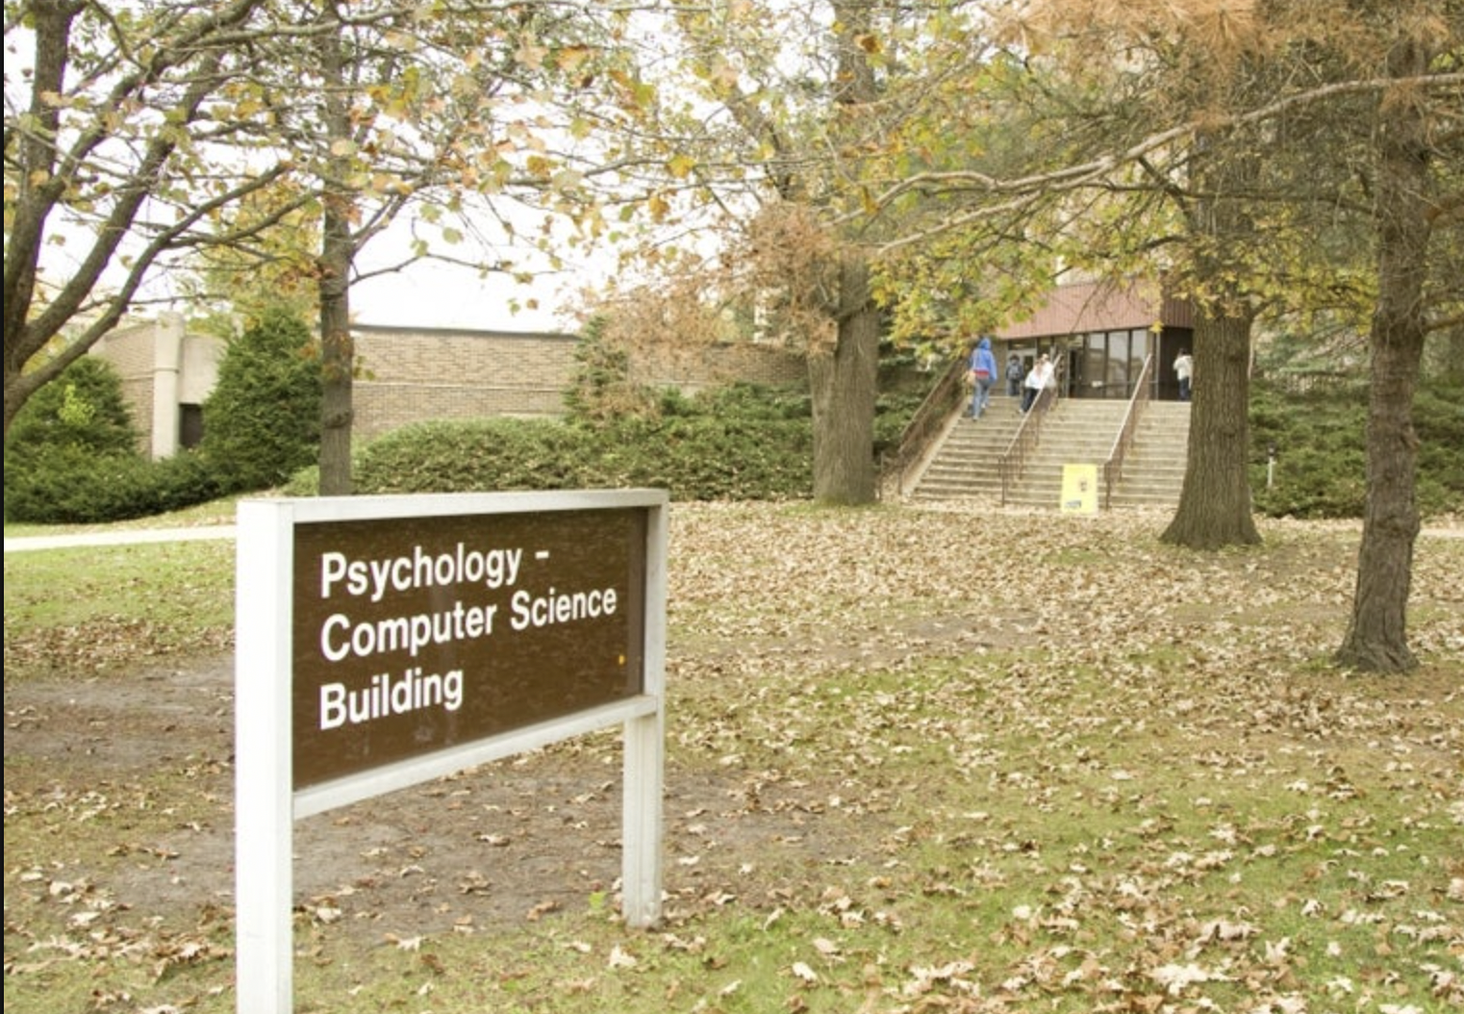




Slide 5
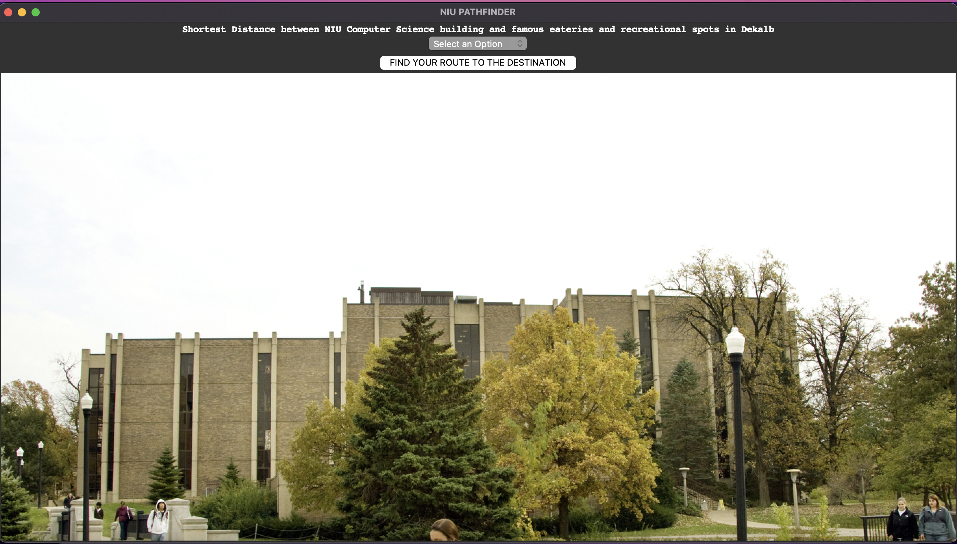
Output Graphical User Interface

Slide 6
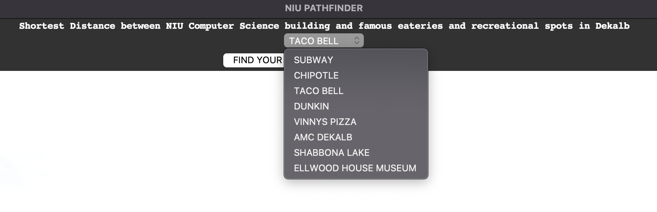

Slide 7
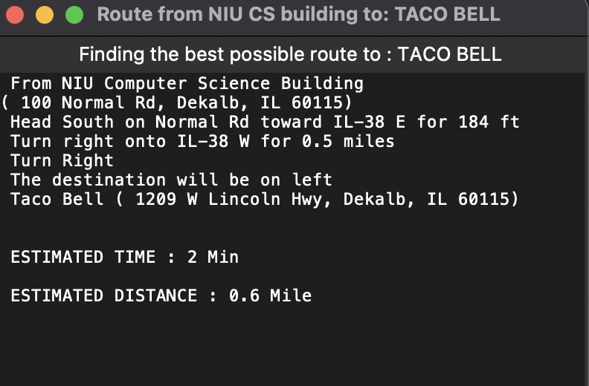
Directions POP UP window :

Slide 8
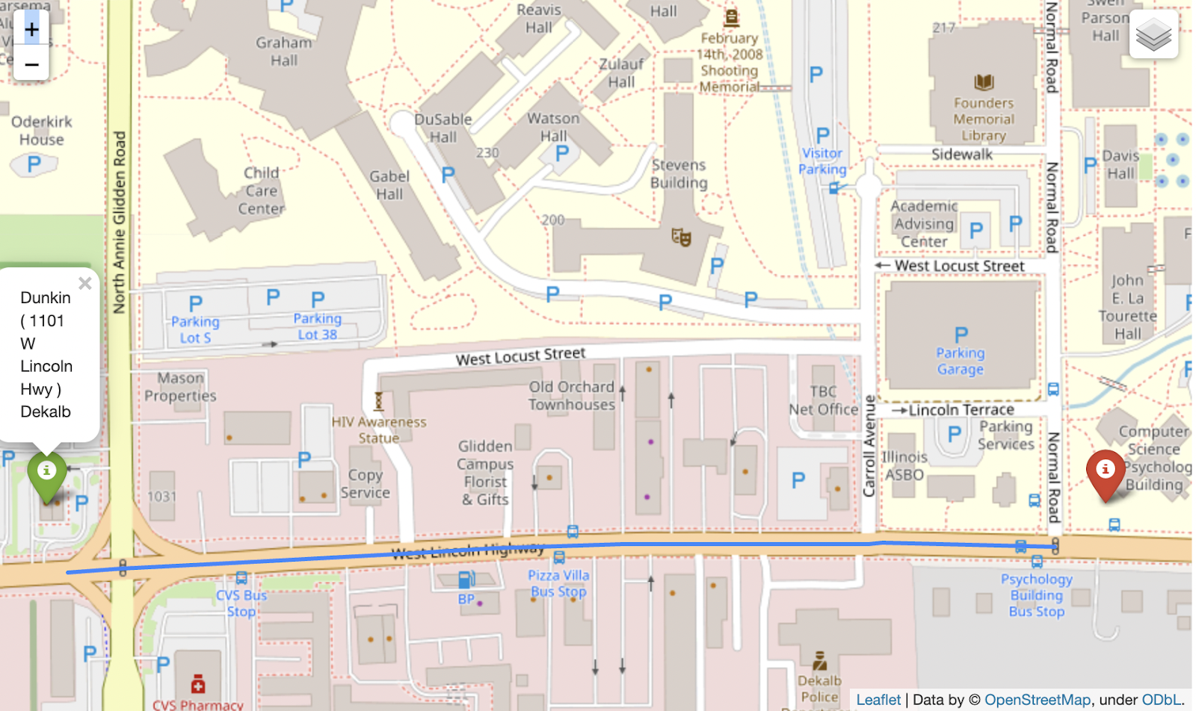
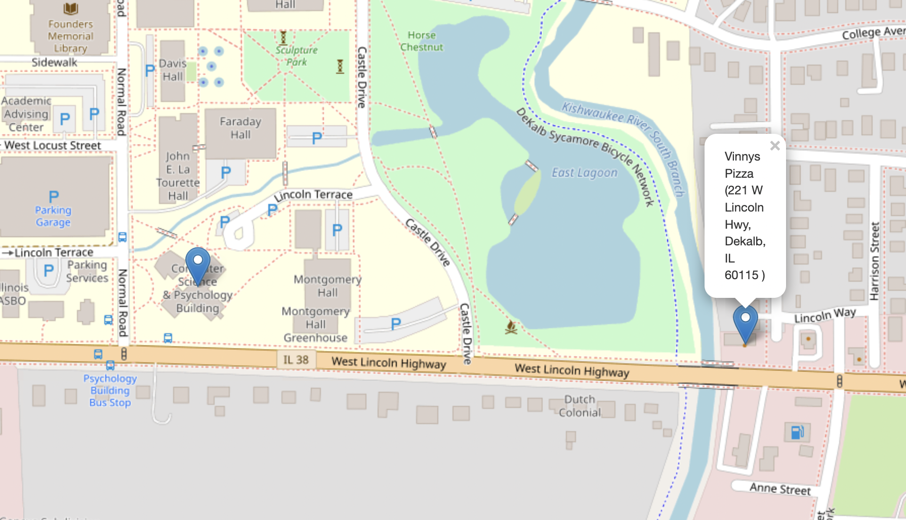
Map Plotting :

Slide 9
Results :
Pop up with directions, estimated time and estimated distance.
Map is saved locally for the user to view in .html
Output map with various backgrounds in notebook with path highlighted and source and destination as markers.

Slide 10
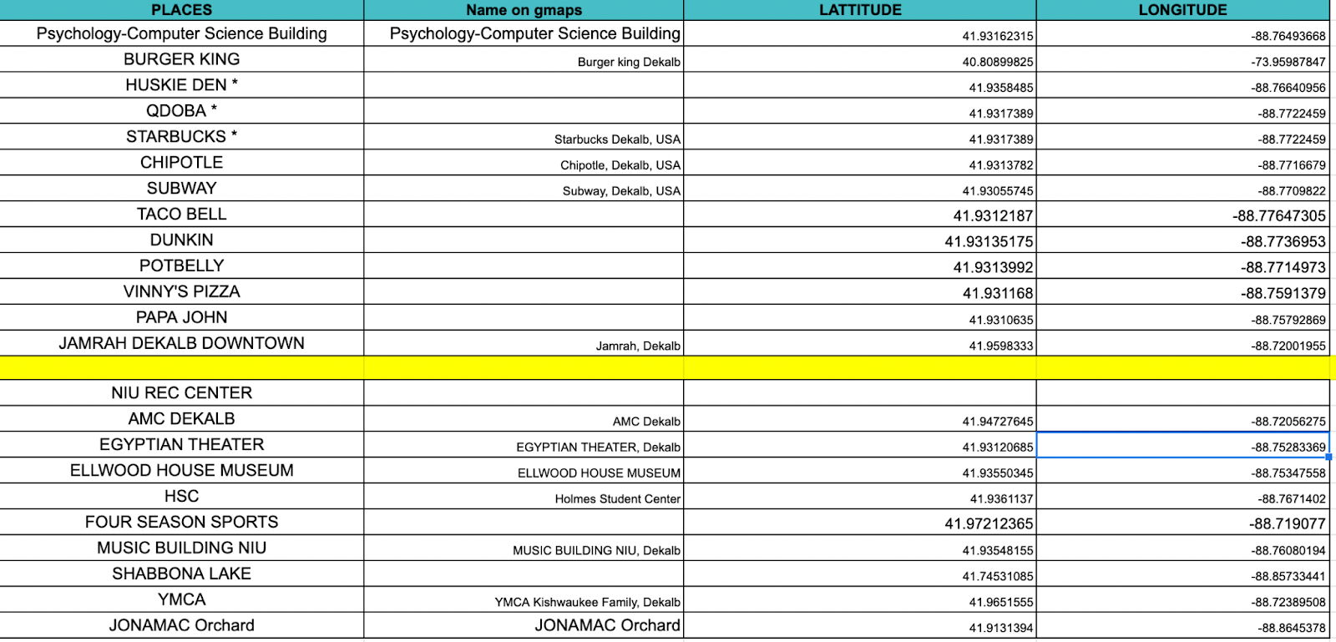
Data Preparation

Slide 11

Algorithm for Graph Model
Dijkstra's Algorithm finds the shortest path between a given node (which is called the "source node") and all other nodes in a graph.
This algorithm uses the weights of the edges to find the path that minimizes the total distance (weight) between the source node and all other nodes.

Slide 12
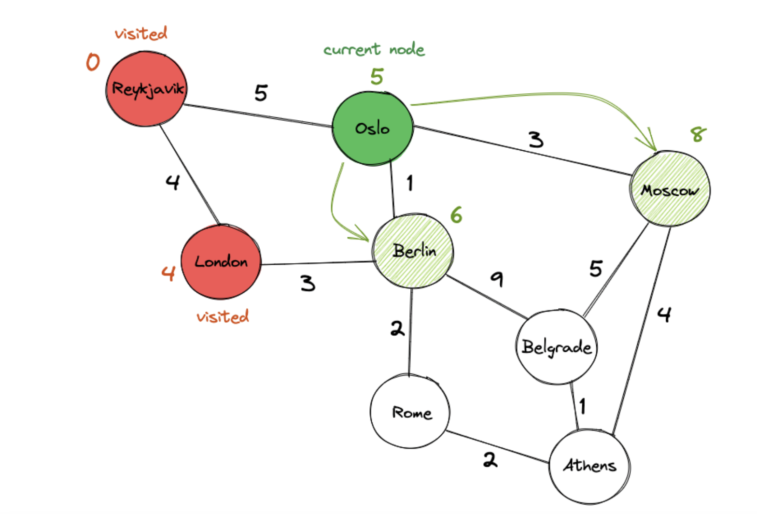

Slide 13
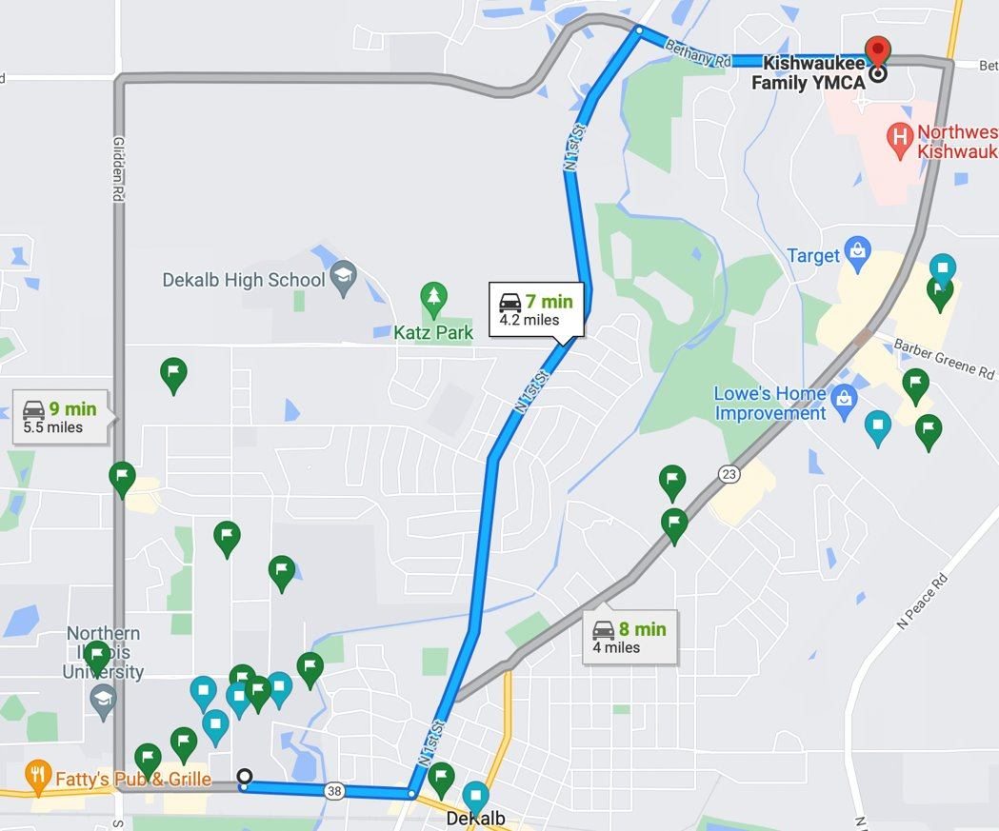
Working : Google map

Slide 14
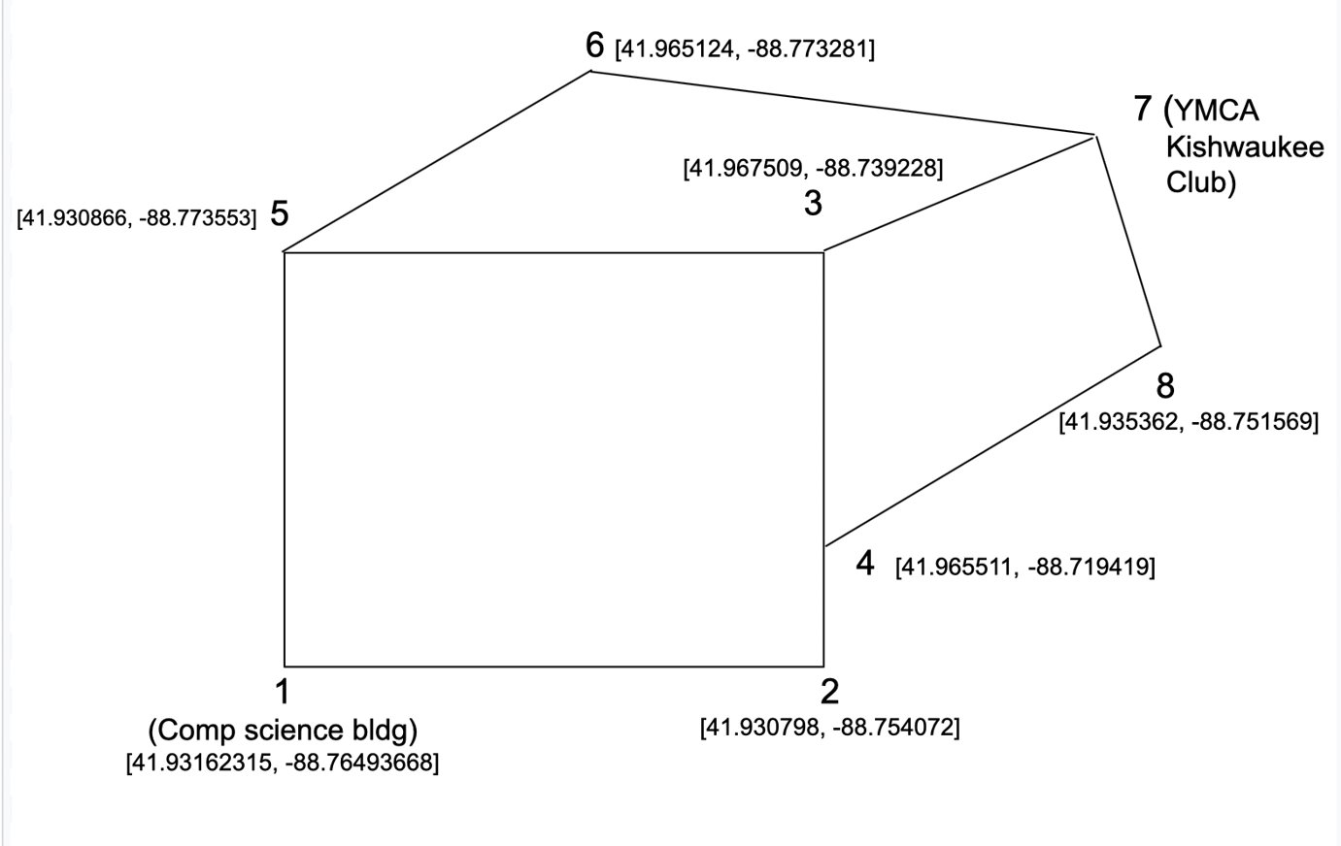
Our Graph :

Slide 15
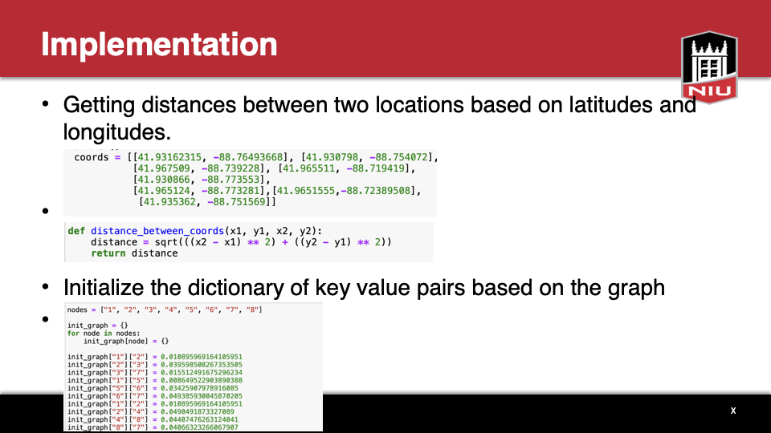

Slide 16
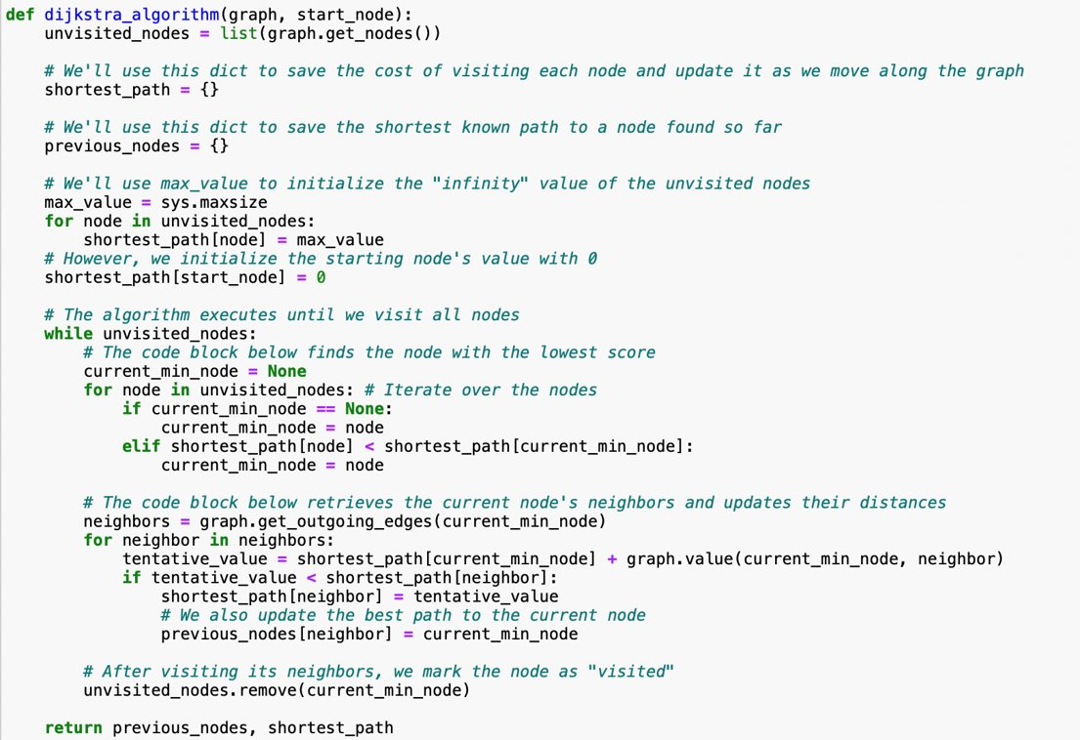
The algorithm

Slide 17
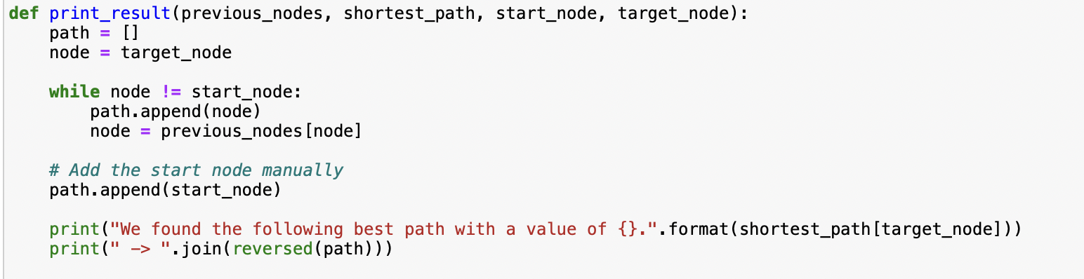
Get the shortest paths

Slide 18







Programming language & system

Slide 19
Future Enhancement
More Destination spots
Full Map Path Outlining
Adapting for Mobile

